Slide 1


Training School # 11
ImageJ API-beating
ImgLib2, ImageJ2 and the Big-Data Viewer
Robert Haase
Based on material by: Tobias Pietzsch, Florian Jug and Pavel Tomancak
February 2nd-5th, 2018
Luxembourg

Slide 2
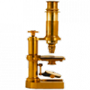
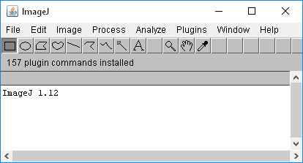
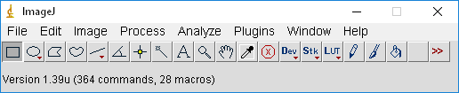
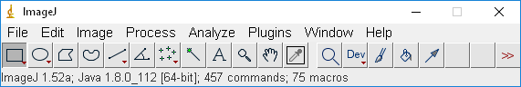

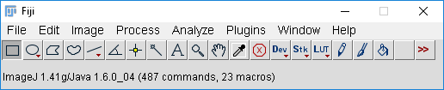
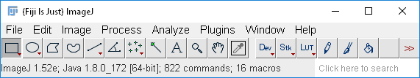
ImageJ & Fiji
ImageJ is a popular tool for image analysis in general
Fiji is a distribution of ImageJ with plugins for image analysis in life sciences.
ImageJ
Fiji
1997
2000
2008
2018

Slide 3
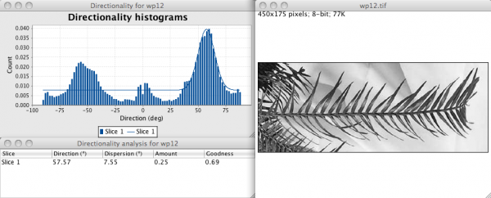
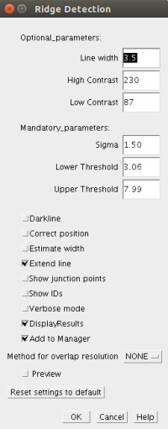
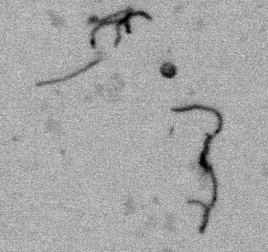
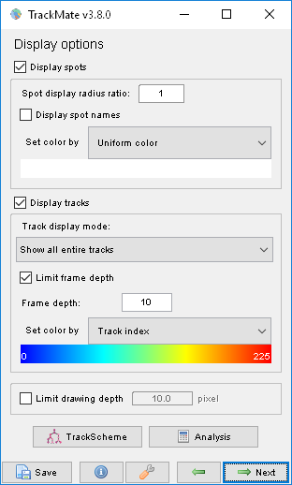
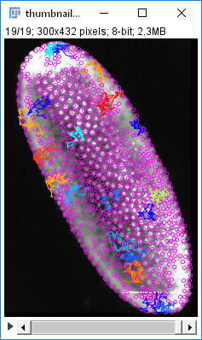
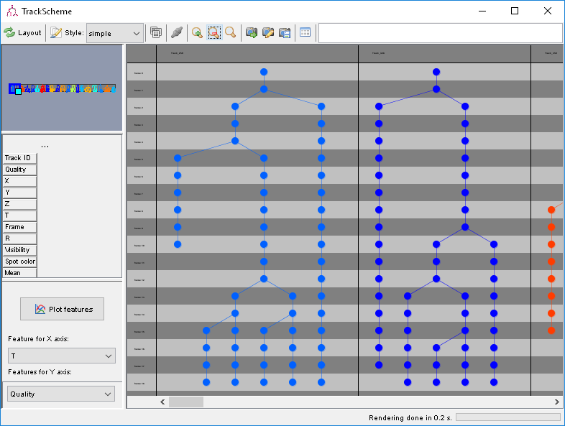
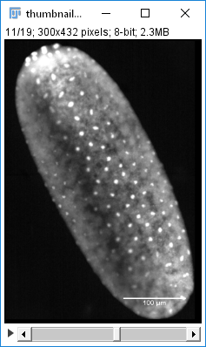
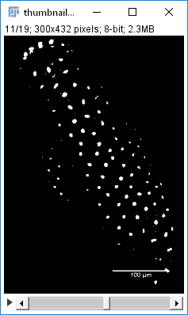
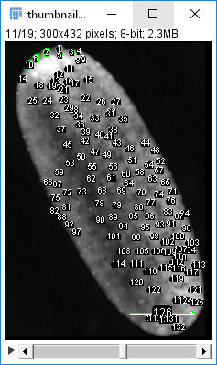
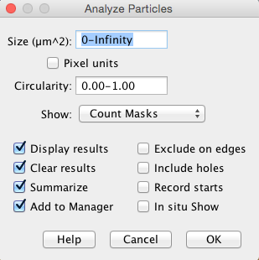
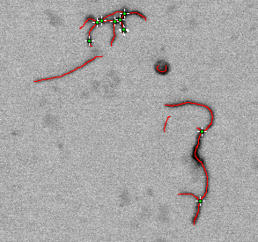
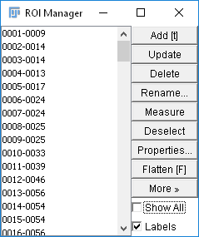
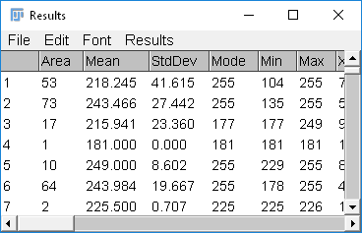
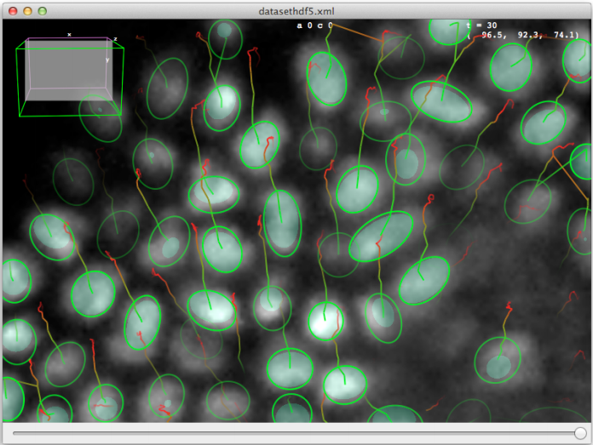
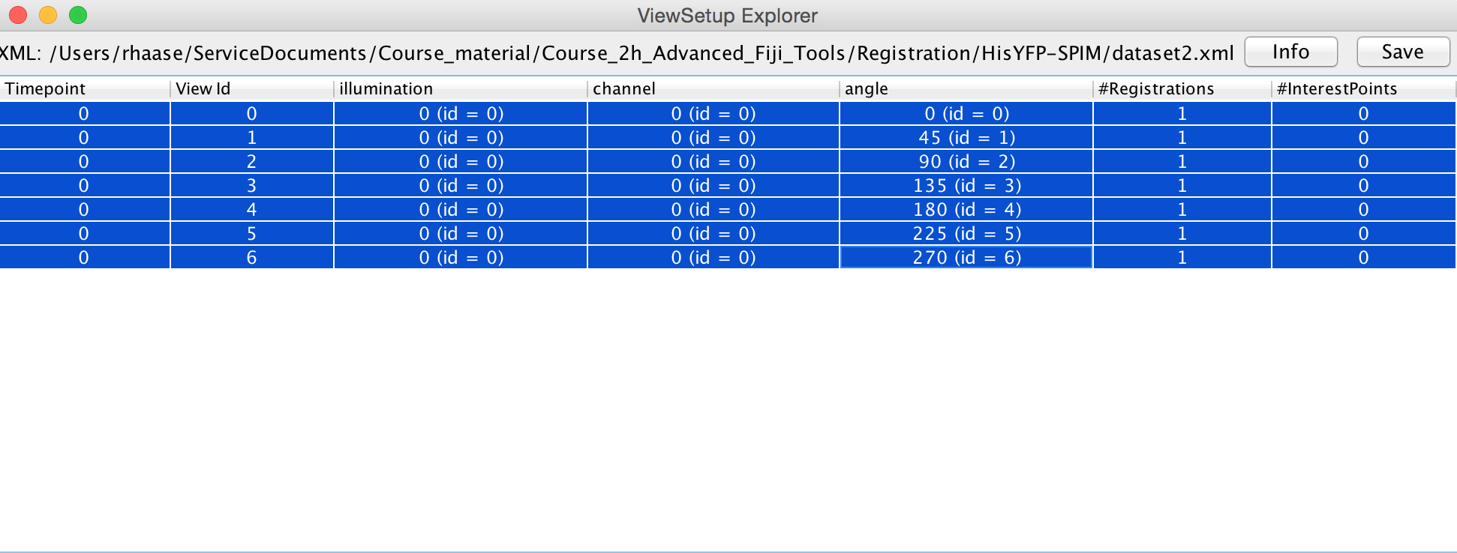
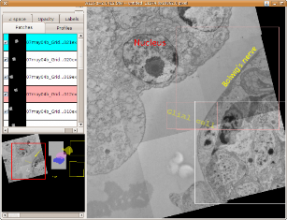
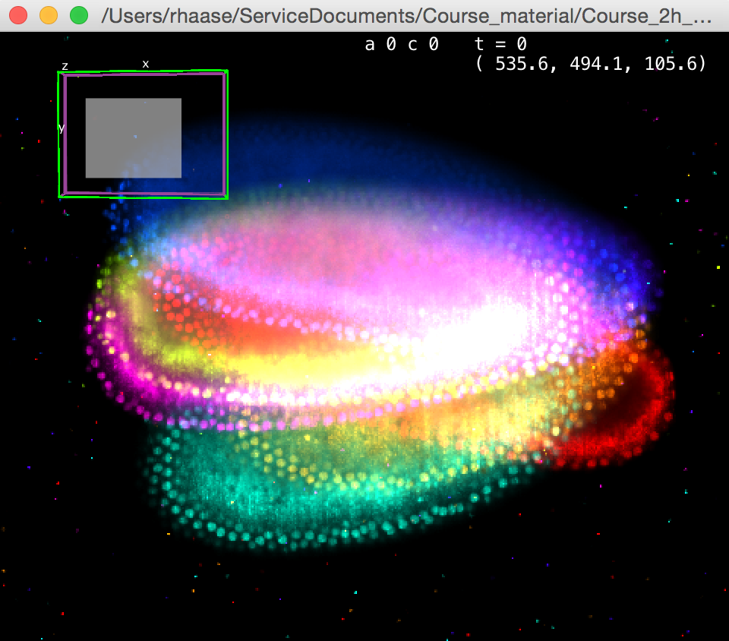
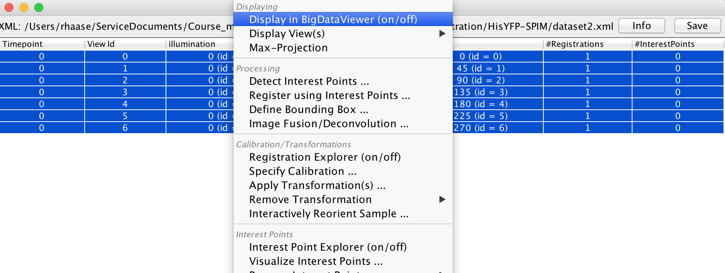
Fiji: Image analysis with the head in clouds
Fiji is just ImageJ + an endless list of sophisticated plugins for life scientists
Core ImageJ
Directionality
Ridge detection
Trackmate
BigDataViewer
Multiview fusion
TrakEM
And 800 more…
Image Source: Jaydeep Sidhaye, Norden Group, MPI CBG

Slide 4
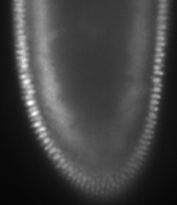
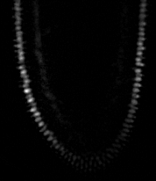

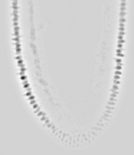
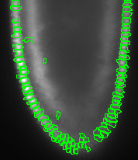

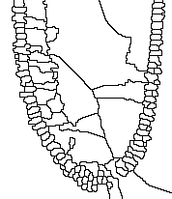
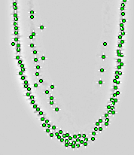
Fiji: Image analysis with feed on the ground
Low level image processing in all shades of grey
Subtract background
Gaussian blur
Division
Maxima detection
ROI manager / visualisation
Particle analysis / filtering
Seeded watershed

Slide 5


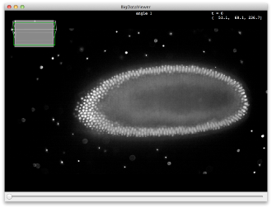
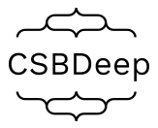
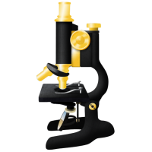


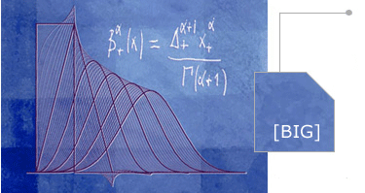


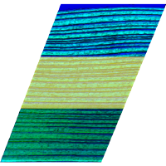



ImageJ & Fiji
ClearVolume
CSBDeep
BioFormats
BigDataViewer
Scenery / SciView
MaMut
ImageJ2
BIG-EPFL
CLIJ
ImageScience
TrakEM2
SCF-MPI-CBG
ImageJ
ImgLib2
BigDataTools
Trackmate
And sooo many more ….
BigDataViewer
SciJava
Fiji

Slide 6
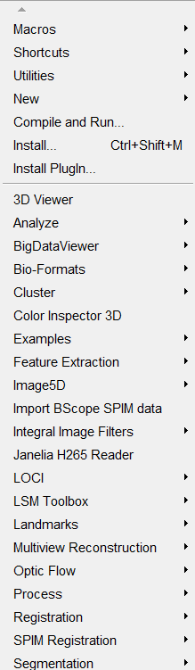
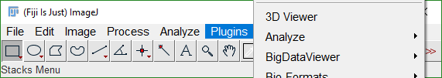
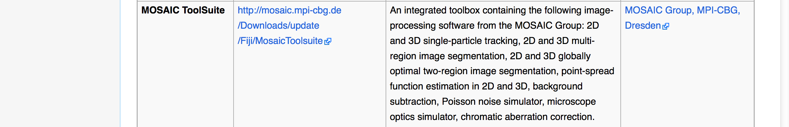
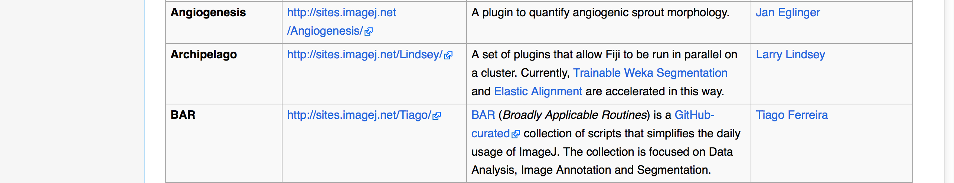
Fiji plugins &update sites
Included plugins for many purposes
Flexibility ☺
Applicability ☺
User experience ☹
Maintenance ☹
Optional plugins: http://imagej.net/List_of_update_sites
Extensibility ☺

Slide 7
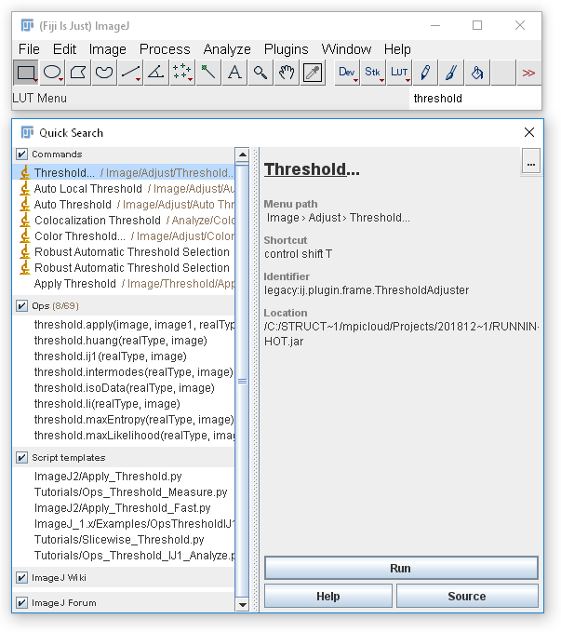
Fiji user experience
The menus are confusing and not very well organized
Use the search field!
It shows you where the plugin is located
You can run it from here (press enter)
Allows you searching
for plugins / menus
Operations (ops)
ImageJ wiki
Forum

Slide 8
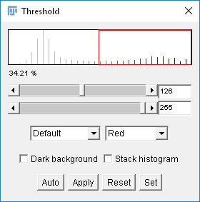
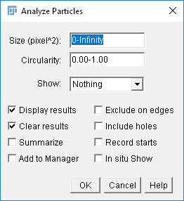
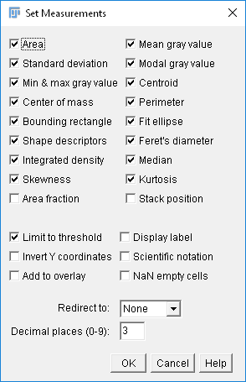
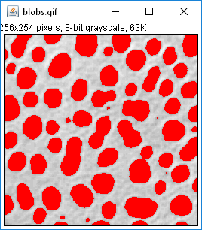
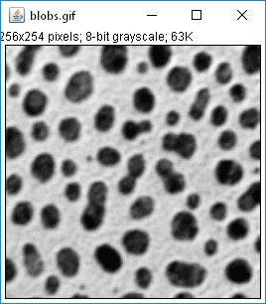
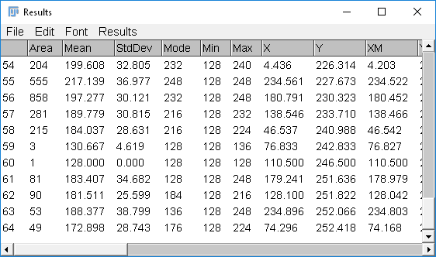
Fiji example workflow
Popular basic analysis pipeline: thresholding + particle analysis
From images to raw data for statistics and *omics post-processing

Slide 9
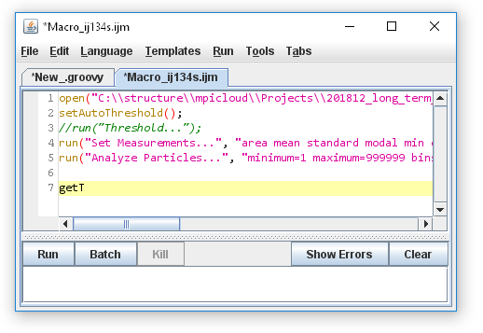
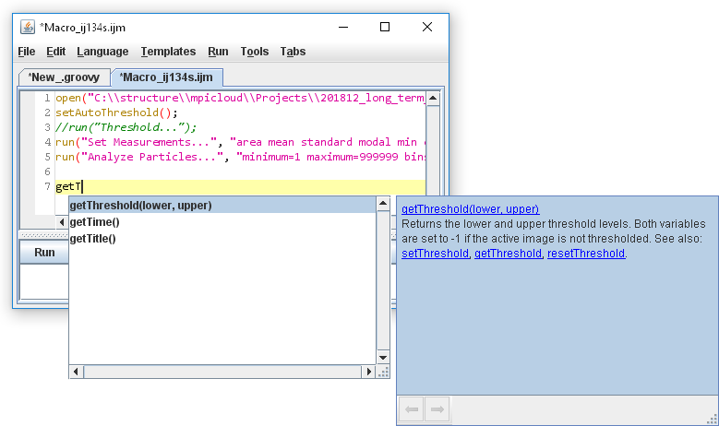
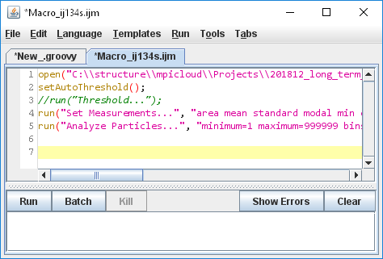
Fiji & reproducible research: macros
The macro recorder and the script editor allow scripting Fiji and thus, reproducible workflows.
Run workflows on hundreds or thousands of images!
Share and publish workflows with others! Make your own update site!

Slide 10
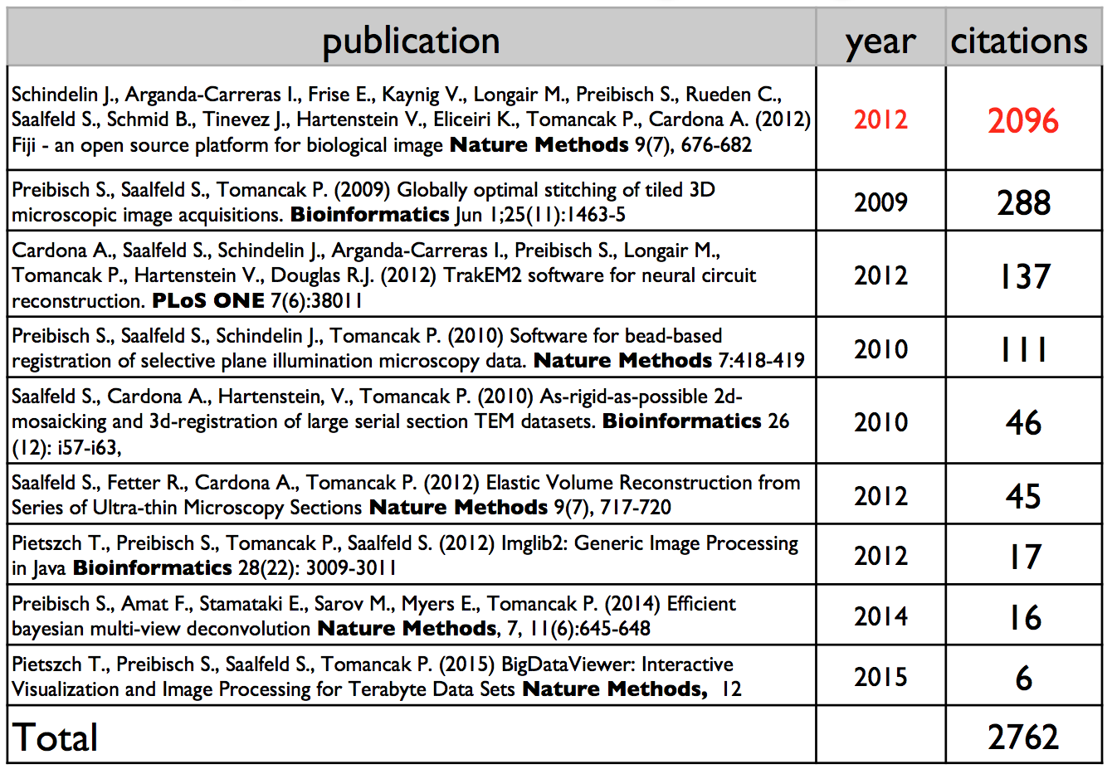
Fiji: Citation
2846
6876
10000
On May 24th 2016
On Nov 29th 2017
In Sept 2018
Slide by courtesy of Pavel Tomancak, MPI-CBG

Slide 11

Fiji usage statistics
Fiji updates per week
Slide by courtesy of Florian Jug and Pavel Tomancak, MPI-CBG

Slide 12



Fiji & friends development: hackathons & learnathons
Developer community meets (at least) annually
Hackathons: core developers meet with plugin developers to bring Fiji on the next level
Learnathons: core developers teach new/potential members of the developer community
Slide by courtesy of Pavel Tomancak, MPI-CBG

Slide 13







The ImageJ2 universe
ImageJ2, ImageJ-Ops, RandomAccessibleIntervals
LabelRegions, SciJava tables, statistics
BigDataViewer, BDVvistools, ARGBType images
GPU-accelerated image processing, CLIJ

Slide 14

Setting up an ImageJ2 workflow
Using Integrated Development Environments (IDE) – today: IntellIJ
Nobody starts “New projects” in the ImageJ developers community.
We all have our own template which we carry with us, modify over time and duplicate to develop new plugins and workflows.
Let’s make a template for you.
Eclipse user? Watch: https://www.youtube.com/watch?v=YIWpoBnnLio

Slide 15

Exercise: Setting up an ImageJ2 workflow
Clone or download the code repository
git clone https://github.com/imagej/example-imagej-command

Slide 16


How to get started
To make maven work, every project needs a pom.xml file.
It contains information about the project and it relationship to ImageJ (dependencies)
You should make one pom.xml for yourself and then copy it to every other new project.
Step 1: Update the parent pom to make your plugin compatible to current ImageJ.
Open pom.xml in a text editor
Visit https://maven.imagej.net
Search for pom-scijava

Slide 17

How to get started
Enter your information to the pom.xml file
No spaces or minuses allowed here
No spaces allowed here
Your domain
Your tool name
Description of your tool
Your website
Your institute website

Slide 18

How to get started
Enter your information to the pom.xml file
You
Your role

Slide 19

How to get started
Enter your information to the pom.xml file
Where is the code hosted?
Where is your Fiji installed?

Slide 20

How to get started
Open the pom.xml file in IntelliJ
Go through the pom.xml to check if everything is right.
Save the pom.xml file (CTRL+S)

Slide 21
ImageJ ecosystem
ImageJ1
ImageJ-Ops
ImageJ2 / Imglib2
The Maven build system
ImageJ-legacy
ImageJ2
ImageJ
-ops
ImageJ1
imglib2
ImageJ-
legacy
My workflow /
plugin
maven

Slide 22
ImageJ1
ImageJ1 architecture grew over the years
IJ
ImagePlus
ImageProcessor
Roi
AutoThresholder
ImageStatistics
At some point a group of developers decided to make ImageJ2 happen.

Slide 23

ImageJ-Ops
What is an operation?
ImageJ-Ops has nice answers to this question. Categorized.

Slide 24

ImageJ-Ops
What is an operation?
Image calculator

Slide 25

ImageJ-Ops
What is an operation?
Any kind of image filters

Slide 26

ImageJ-Ops
What is an operation?
Deconvolution!

Slide 27

ImageJ-Ops
What is an operation?
Morphological filters

Slide 28

ImageJ-Ops
What is an operation?
ImageJ1 users find all threshold goodies in ImageJ-Ops

Slide 29

ImageJ-Ops
What is an operation?
Connected Components Analysis; the “Particle Analyser”

Slide 30

ImageJ-Ops
What is an operation?
Image -> Features

Slide 31

ImageJ-Ops
What is an operation?
Image -> Geometric object -> Features

Slide 32


ImageJ2
The good news: It works from Fijis script editor in Python (Jython actually)
The bad news: To use it conveniently, you need different tools.

Slide 33
ImageJ2
What is an image?
An image is a set of pixels which can be randomly accessed.
An image is a set of pixels which can be iterated through.
An image is an n-dimensional interval of pixels, spatially or temporarily associated.

Slide 34
ImageJ2
What is an image?
An image is a set of pixels which can be randomly accessed.
An image is a set of pixels which can be iterated through.
An image is an n-dimensional interval of pixels, spatially or temporarily associated.
RandomAccessible
Iterable
Interval
RandomAccessibleInterval
IterableInterval
Img

Slide 35

ImageJ2
The class hierarchy in more detail
Read the supplement of this paper!
ImgLib2—generic image processing in Java. Tobias Pietzsch, Stephan Preibisch, Pavel Tomančák, and Stephan Saalfeld. Bioinformatics. 2012 Nov 15; 28(22): 3009–3011

Slide 36


ImageJ2
Create images and wrangle types
Every Img is a RandomAccessibleInterval. But not every RandomAccessibleInterval is an Img!

Slide 37



ImageJ2
Casting
ALT+ENTER
ENTER

Slide 38

ImageJ2
Types
Parameter type
Parameter type
Return type

Slide 39


ImageJ2
Converting
CTR+P

Slide 40


ImageJ2
Converting

Slide 41

ImageJ2
Wrapping

Slide 42
Useful links
https://imagej.net/ImgLib2
http://forum.imagej.net/tags/c/development/imglib
https://github.com/imglib/imglib2-tutorials
https://github.com/imglib/imglib2-introductory-workshop
https://github.com/imglib/imglib2-advanced-workshop
https://github.com/imglib/imglib2-cache-examples

Slide 43
ImageJ ecosystem
ImageJ1
ImageJ-Ops
ImageJ2
The Maven build system
ImageJ-legacy

Slide 44


The maven build system
ImageJ projects are organized with maven.
https://maven.apache.org/
The pom.xml file we just created is a Maven project file.
The most important maven commands are
package: make a jar-file ready for ImageJ
install to ImageJ folder
deploy to an online
repository
test: execute unit tests

Slide 45


Renaming packages
Rename the main package by entering your organisations url. Minuses – are not allowed.

Slide 46

Rename classes
Open the GaussFiltering class and rename it

Slide 47

Getting started
Empty the class to get an empty work space

Slide 48


Enter a hello world message and run the program!
Welcome to ImageJ2!

Slide 49






ImageJ legacy
Add a dependency to imagej-legacy and run your program again!

Slide 50

Before continuing
Copy this project now!
This is the starting point for your future ImageJ projects!
The things we do next, are also available on github – as branches
https://github.com/haesleinhuepf/
NEUBIAS_TS11.git

Slide 51
10 Minutes break. Then we get our hands dirty!

Slide 52



ImageJ2
If you prefer ImageJs python programming, consider having IDE and Fiji open in parallel.

Slide 53


Summary
The power of ImageJ2 is a bit hidden
Use auto-completion of your IDE to discover it!
Press CTRL+P to find out parameters of a method
Improve the general discoverability by giving things good names. Use SHIFT+F6 to rename methods, classes,…
If there are issues
Use ALT+Enter to resolve them
Choose your IDE wisely and stick to it
They are all good. But you need to learn how to use them.
Choose your favorite programming language.
Don’t fight the fight Java versus Python. Consider becoming language agnostic.
Learn one properly. Learn a second. Do whatever fit’s best in your environment and stick to it.
Become expert and never stop learning.

